Slide 1
CG- MODULE 1

Slide 2
The term computer graphics includes almost everything on computers that is not text or sound.
Computer graphics is art of drawing pictures on computers, also called as rendering.
Computer Graphics express data in pictorial form.
It displays information in the form of graphics objects such as pictures, charts ,graphs etc instead of simply text.
Computer graphics is an art of drawing pictures, lines, charts, etc using computers with the help of programming.

Slide 3
Applications of computer graphics
Movie industry
Games
Medical Imaging and Scientific Visualization
Computer Aided Design
Education & training
Simulators used for training ship captains,pilots
Computer Art
Presentation graphics
Image processing
GUI

Slide 4
A display area is represented as a collection of discrete picture elements called pixels.
Pixel is the smallest addressable unit on the screen. Each pixel has got some information like its intensity and color.
Basically there are two types of computer graphics namely Interactive Computer Graphics and Passive computer graphics

Slide 5
Interactive Computer Graphics
It involves a two way communication between computer and user.
The observer is given some control over the image by providing him with an input device .
For example: Observer send his request to the computer through video game controller. Computer on receiving signals can modify the displayed picture appropriately.
Non Interactive Computer Graphics
It is also known as passive computer graphics.
The user does not have any kind of control over the image.
It involves only a one way communication.
The image is merely the product of static stored program and will work according to the instructions given in the program linearly.
The image is totally under the control of program instructions, not under the user. Example: images shown on television.

Slide 6
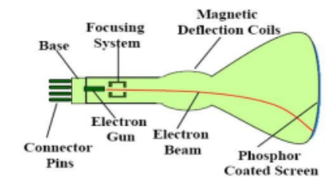
Video Display Devices: CRT
The primary output device in a graphics system is a video monitor.
The operation of most video monitors is based on the standard cathode ray tube (CRT).

Slide 7
The beam of electrons are emitted by an electron gun. It passes through focusing and deflection systems that direct the beam toward specified positions on the phosphor coated screen.
Thus phosphor emits a small spot of light at each position contacted by the electron beam.
Because the light emitted by the phosphor fades very rapidly, some method is needed for maintaining the screen picture.
One way to keep the phosphor glowing is to redraw the picture repeatedly by quickly directing the electron beam back over the same points. This type of display is called a refresh CRT
The primary components of an electron gun in a CRT are the heated metal, cathode and a control grid.

Slide 8
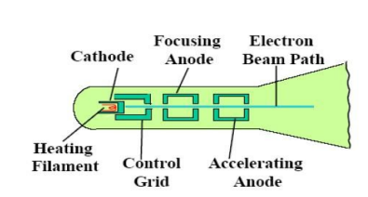
Heat is supplied to the cathode by directing a current through a coil of wire, called the filament. This causes electrons to be ‘boiled off" the hot cathode surface.
Intensity of the electron beam is controlled by setting voltage levels on the control grid, which is a metal cylinder that fits over the cathode.
Amount of light emitted by the phosphor coating depends on the number of electrons striking the screen, thus we control the brightness of a display by varying the voltage on the control grid.

Slide 9
A smaller negative voltage on the control grid simply decreases the number of electrons passing through the small hole at the end of the control grid structure.
A high negative voltage applied will stop electrons from passing through it.
The focusing system force the electron beam to converge into a small spot as it strikes the phosphor. Otherwise, the electrons would repel each other, and the beam would spread out as it approaches the screen.
Focusing is accomplished with the help of either electric or magnetic fields.
It is commonly constructed with a pair of magnetic deflection coils mounted on CRT envelope. The magnetic field produced by each pair of coils directs the electron beam properly. Horizontal deflection is accomplished with one pair of coils, and vertical deflection by the other pair.

Slide 10
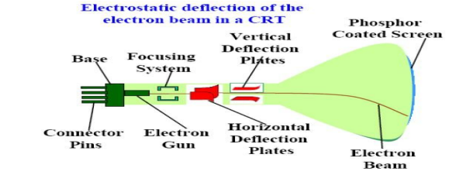
When electrostatic deflection is used, two pairs of parallel plates are mounted inside the CRT envelope. One pair of plates is mounted horizontally to control the vertical deflection, and the other pair is mounted vertically to control horizontal deflection.

Slide 11
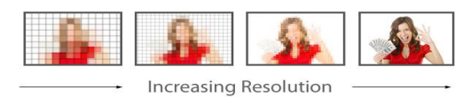
Persistence
Persistence is defined as the time CRT takes to decay the emitted light from the screen to one tenth of its original intensity. Lower persistence phosphor require high refresh rate. Graphics monitors are usually constructed with a persistence in the range from 10 to 60 microseconds.
Resolution
The maximum number of points that can be displayed without overlap on a CRT. Higher resolution systems are often referred to as high-definition systems.

Slide 12
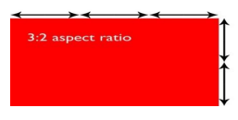
Aspect Ratio :
The ratio of vertical points to horizontal points necessary to produce equal length lines in both direction on the screen. It is the ratio of horizontal to vertical points.

Slide 13
Raster scan display
It is the most common type of CRT monitor.
In this system, the electron beam is swept across the screen one row at a time from top to bottom.
Beam intensity is turned on and off to create a pattern of illuminated spots as the electron moves across each row.
In a raster scan system entire screen is considered as a matrix of pixels.
Each screen point is referred to as a pixel or pel (shortened form of picture element).
Frame buffer or refresh buffer is a memory where picture definition is stored .i.e. set of all intensity values for all pixels is stored in refresh buffer.

Slide 14
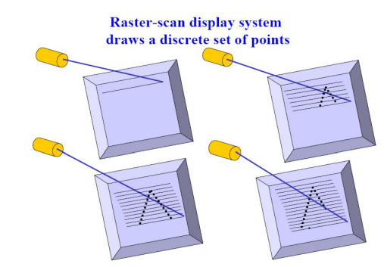

Slide 15
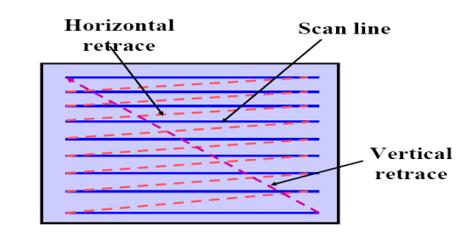
Horizontal Retrace: At the end of each scan line , the electron beam returns to the left side of the screen to begin displaying the next scan line.
Vertical retrace: At the end of each frame the electron beam returns to the top left corner of the screen to begin the next frame.

Slide 16
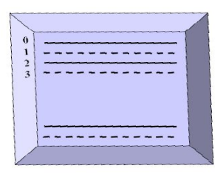
Interlacing: In this method, each frame is displayed in two passes using an interlaced refresh procedure. First all the points on the even numbered scanlines are displayed ,and then all the odd numbered lines are displayed. Entire screen is displayed in half time , providing that adjacent scanlines contain similar information.

Slide 17
In a simple black and white system, each screen point is either on or off, so only one bit per pixel is needed to control the intensity of screen positions.
Bit value of 1 indicates that the electron beam is to be turned on that position, and a value of 0 indicates that the beam intensity is to be turned off.
Additional bits are needed when color and intensity variations are to be displayed.
On a black-and-white system with one bit per pixeI, the frame buffer is commonly called a bitmap.
For systems with multiple bits per pixel, the frame buffer is referred to as a pixmap.
Refreshing on raster scan displays is carried out at the rate of 60 to 80 frames per second.
Home television sets and printers are examples of other systems using raster-scan methods.

Slide 18
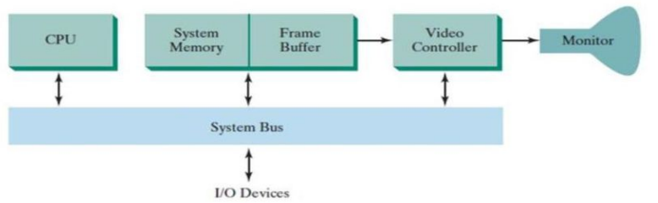
RASTER-SCAN SYSTEMS
In Interactive raster graphics systems, in addition to the CPU ,a special-purpose processor, called the video controller or display controller, is used to control the operation of the display device.

Slide 19
A fixed area of the system memory is reserved for the frame buffer, and the video controller is given direct access to the frame-buffer memory.
Frame-buffer locations, and the corresponding screen positions, are referenced in Cartesian coordinates.
For many graphics monitors, the coordinate origin is defined at the lower left screen corner.
The screen surface is represented as the first quadrant of a two-dimensional system, with positive x values increasing to the right and positive y values increasing from bottom to top.
Scan lines are then labeled from y_{max} at the top of the screen to 0 at the bottom.
Along each scan line, screen pixel positions are labeled from 0 to x_{max}.
On some personal computers, the coordinate origin is referenced at the upper left comer of the screen, so the y values are inverted.

Slide 20
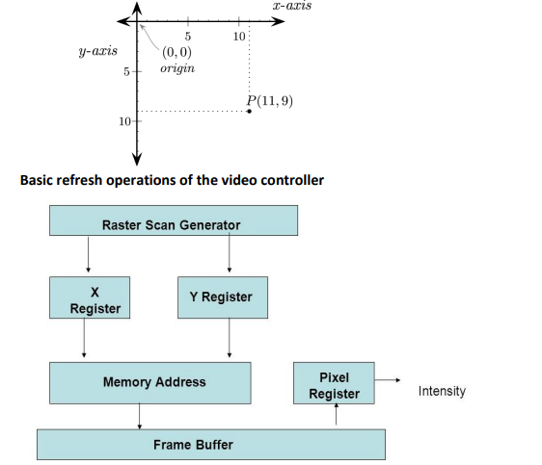

Slide 21
Two registers are used to store the coordinates of the screen pixels: x register and y register.
Initially, x register is set to 0 and the y register is set to y_{max}.
The value stored in the frame buffer for this pixel position is then retrieved and used to set the intensity of the CRT beam.
Then the x register is incremented by 1, and the process repeated for the next pixel on the top scan line.
This procedure is repeated for each pixel along the scan line.
After the last pixel on the top scan line has been processed, the x register is reset to 0 and the y register is decremented by 1.
Pixels along this scan line are then processed in turn, and the procedure is repeated for each successive scan line.
After cycling through all pixels along the bottom scan line (y = 0), the video controller resets the registers to the first pixel position on the top scan line and the refresh process starts over.

Slide 22
To speed up pixel processing, video controllers can retrieve multiple pixel values from the refresh buffer on each pass.
The multiple pixel intensities are then stored in a separate register called pixel register and used to control the CRT beam intensity for a group of adjacent pixels.
In addition to the system memory, a separate display processor memory area can also be provided. Main purpose is digitizing a picture definition given in an application program into a set of pixel-intensity values for storage in the frame buffer. This digitization process is caIled scan conversion.

Slide 23
Random scan display
It is also called as calligraphic displays, vector displays, stroke displays.
The electron beam is directed only to the parts of the screen where a picture is to be drawn.
Random scan monitors draw a picture one line at a time.
A pen plotter operates in a similar way and is an example of a random-scan, hard-copy device.
Picture definition is stored as a set of line drawing commands in an area of memory referred to as refresh display file/refresh buffer.
To display a specified picture ,the system cycles through a set of commands in the display file , drawing each component line.
After all line drawing commands have been processed, the system cycles back to the first line command in the list.
Random-scan displays are scan displays are designed to draw all the component lines of a picture 30 to 60 times

Slide 24
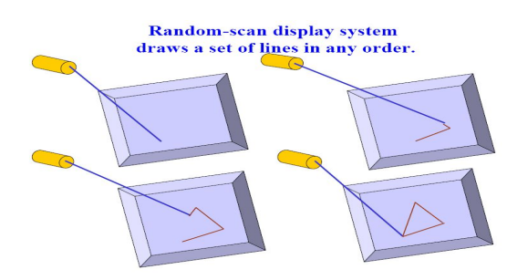

Slide 25
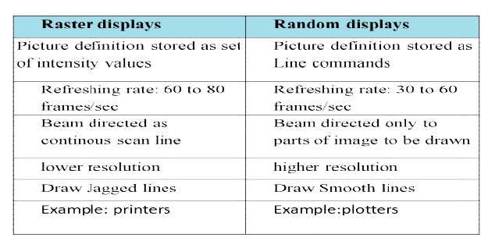

Slide 26
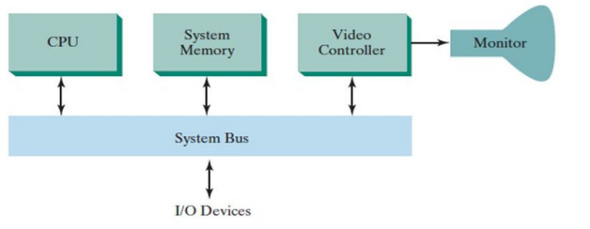
RANDOM-SCAN SYSTEMS

Slide 27
An application program is input and stored in the system memory along with a graphics package.
Graphics commands in the application program are translated by the graphics package into a display file stored in the system memory.
This display file is then accessed by the display processor to refresh the screen.
The display processor cycles through each command in the display file program once during every refresh cycle.
Sometimes the display processor in a random-scan system is referred to as a display processing unit or a graphics controller.
Graphics patterns are drawn on a random-scan system by directing the electron beam along the component lines of the picture.
Lines are defined by the values for their coordinate endpoints, and these input coordinate values are converted to x and y deflection voltages.
A scene is then drawn one line at a time by positioning the beam to fill in the line between specified endpoints.

Slide 28
LINE DRAWING ALGORITHMS
There are two algorithms for drawing a line
DDA line drawing algorithm
Bresenham’s line drawing algorithm

Slide 29

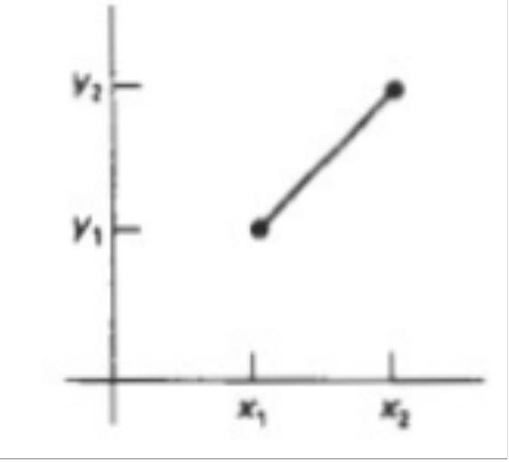



Principle
used for line drawing
algorithms
with m representing the
slope of the line and b
as
the
y intercept.
•
Given that the two endpoints of a line
segment are specified at positions (x 1,y1) and (x2, y2), as shown in Figure.
•
We can determine the slope m and y
intercept b
Algorithms for displaying straight lines
are based on the line equation (1) and the
ca⁹l/c²¹u/l²a⁰t²i⁰ons given in Eqs. (2)
9

Slide 30
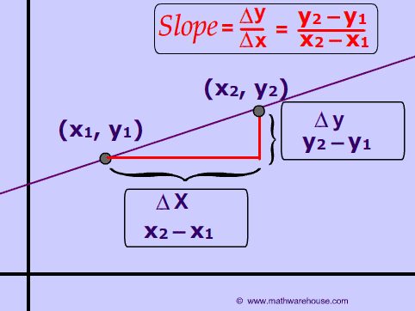

Slide 31
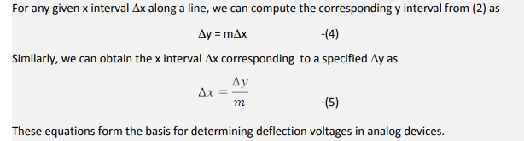

Slide 32
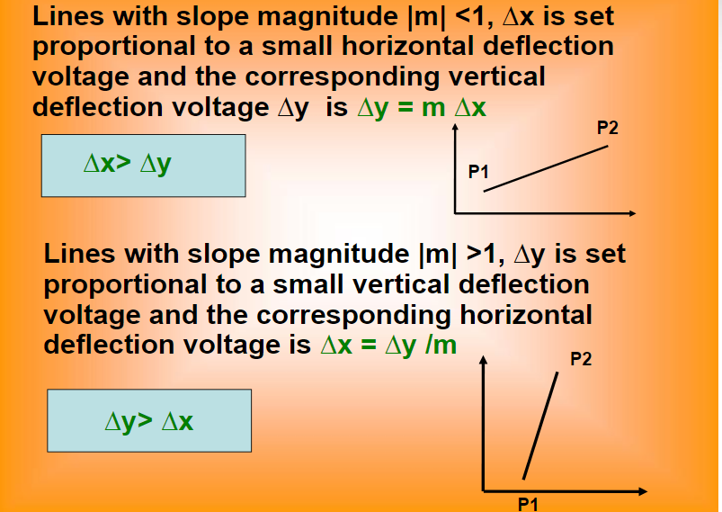

Slide 33
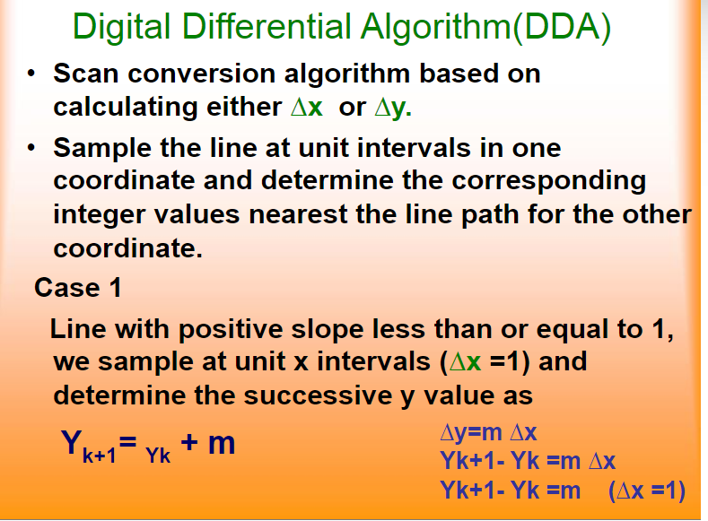

Slide 34
•
k takes
integer values
starting
from
1 and reached.
increases by 1 until
the final
point
is
•
•
m can be any number
between
0 and
1.
off
Calculated y values the nearest integer.
must
be rounded
to
•
For lines
with positive
slope
greater
than
1,
(~y = 1) and
x value as
sample
at unit y intervals
calculate
each successive
Xk+1= xk + 11m
The above eqns are based on the assumption
that lines are processed
from
left
to right.
If
the processing
is reversed then
~x =
~Y =
Yk+1 = Y k - m -_
Xk+1 = xk-1/m
MAHAGURU INSTITUTE OF TECHNOLOGY
-1
-1
&
&
Slope >1
Slope <1

Slide 35
ALGORITHM
Step1: Input two end point pixel positions (x1, y1) and (x2, y2)
Step2: Find horizontal and vertical difference between the end points
dx = x2-x1
dy = y2-y1
Step3: The difference with the greater magnitude determines the value of parameter steps
If abs (dx)>abs (dy) then steps = abs (dx)
else
steps = abs (dy)
Step4: Starting with pixel position (x1, y1) be determined offset needed at each step to generate next pixel along the line path.
xincrment = dx/steps yincrement =dy/steps
step5: Loop through this process steps times.
x = x + xincrement
y = y + yincrement
Step6:Plot the pixel at (x, y) position, set pixel (round(x), round(y).

Slide 36
Advantages
•
It is the simplest algorithm and it does not require special skills for implementation.
It is a faster method for calculating pixel positions than the direct use of equation y=mx + b.
•
Disadvantages:
•
The rounding operation & floating point arithmetic are time consuming procedures.
Perform integer arithmetic by storing float as integers in numerator and denominator and performing integer arithmetic
(2) Round-off error can cause the calculated pixel position to drift away from the true line path for long line segment. Hence end point accuracy is poor.
20

Slide 37
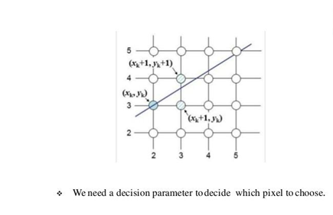
Bresenham’s line drawing algorithm

Slide 38
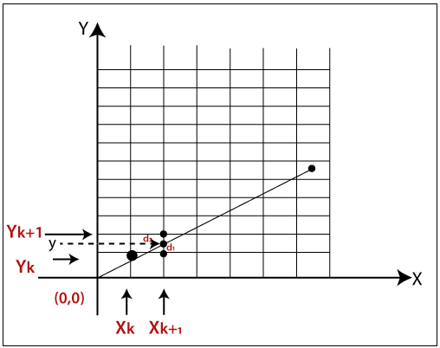
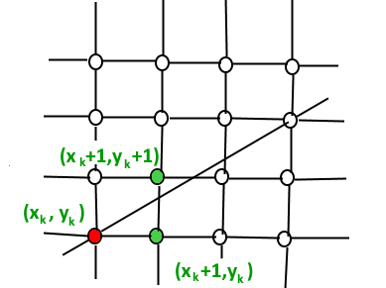
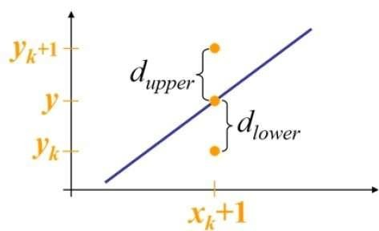

Slide 39
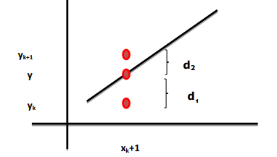
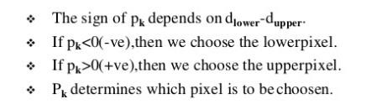

Slide 40
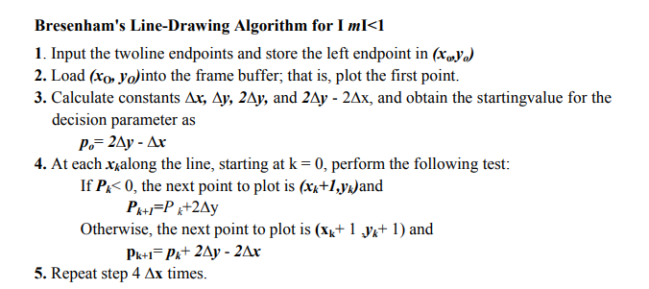

Slide 41
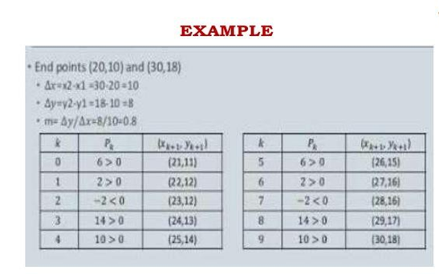

Slide 42
ADVANTAGES
•
Bresenham’s algorithm generally faster
than DDA
•
Bresenham’s algorithm uses integer arithmetic
•
Constants need to be computed
only
once
•
•
Reduces complexity
More accurate than DDA

Slide 43
CIRCLE
DRAWING
ALGORITHMS
There are two algorithms for generating a circle
Midpoint circle drawing algorithm
Bresenham’s circle drawing algorithm

Slide 44
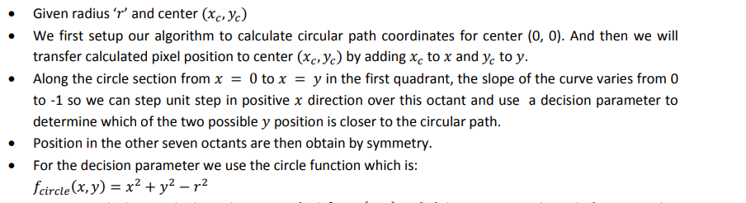
MID POINT CIRCLE DRAWING
ALGORITHM

Slide 45

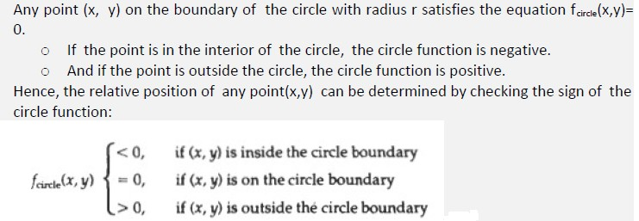
40

Slide 46
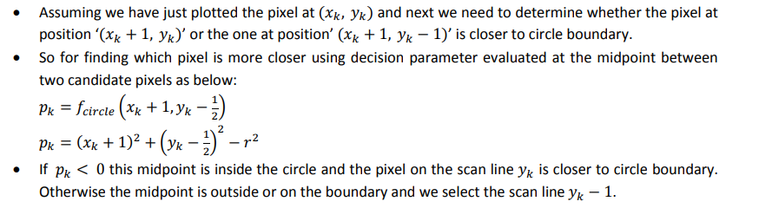

Slide 47
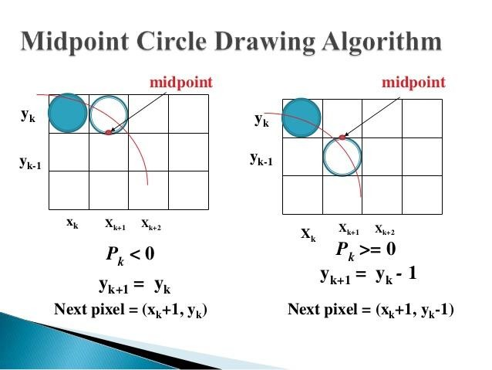

Slide 48
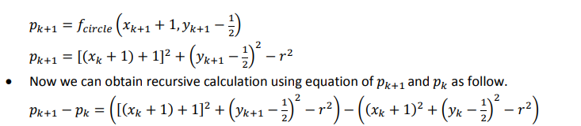

Slide 49
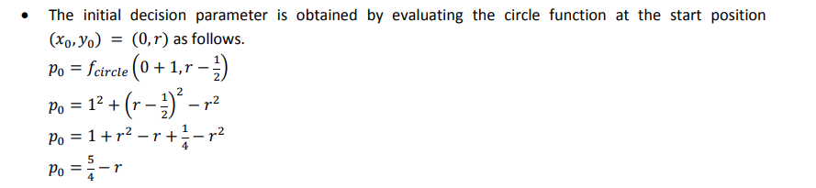

Slide 50
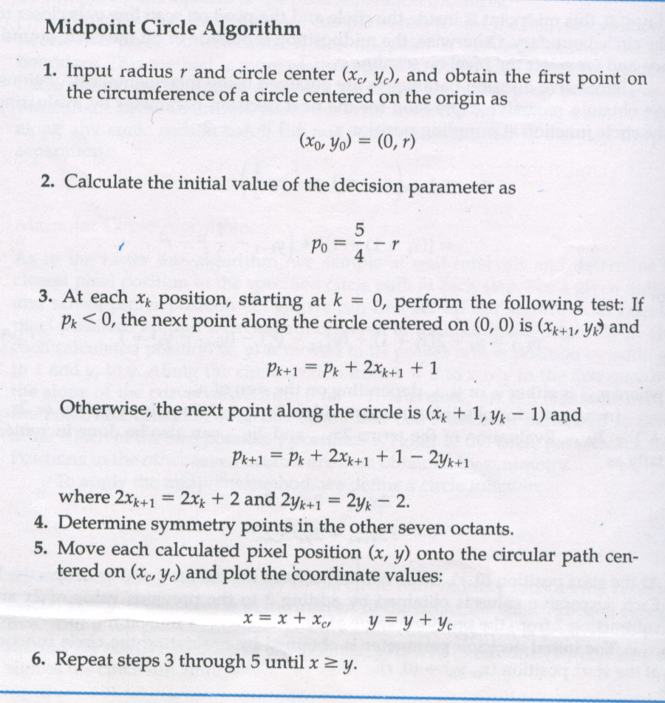

Slide 51
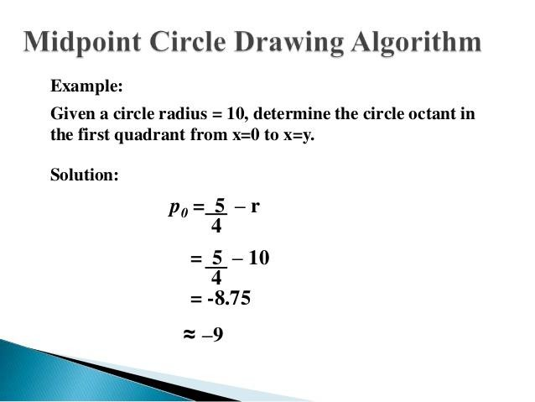

Slide 52
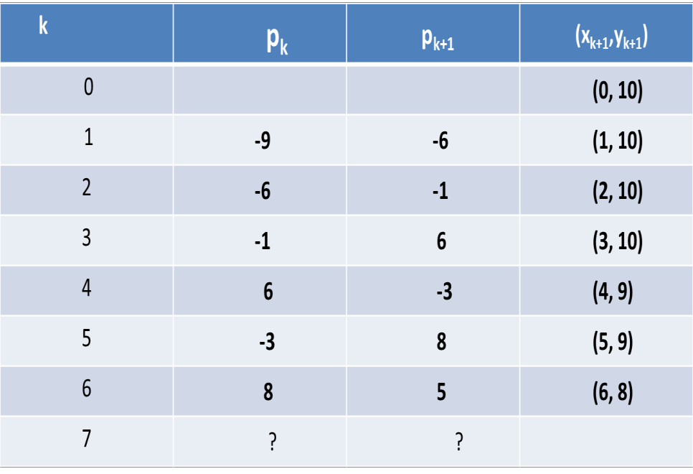

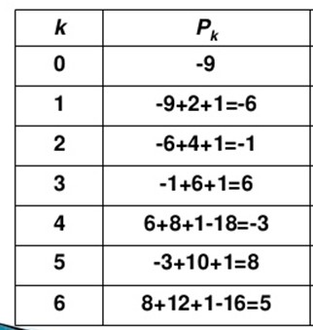

Slide 53
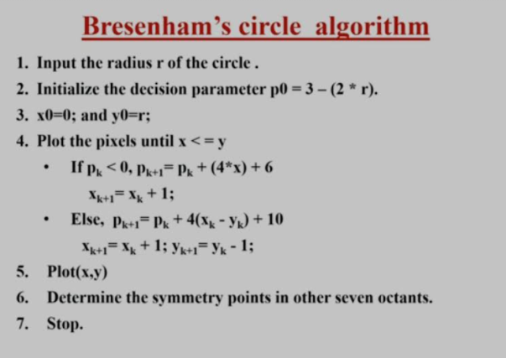

Slide 54
•
The radius of a circle is 8, and center point coordinates
0). Apply bresenham’s circle drawing algorithm to plot points of the circle.
are
all
(0,
(xo ,yo) =(0,r) =(0,8)
Now, we will calculate
the initial decision parameter (P0⁾
P0 =
P₀ =
P₀ =
3 – 2 x r
3 – 2 x 8
-13
The value
Thus,
of initial parameter
P0 < 0. So,
case 1 is satisfied.
xk+1
y_{k+1}
P_{k+1}
=xk + 1 = 0 +
=y_{k} = 8
1 = 1
= Pk +
4xk+1
+ 6 = –13 +
(4 x 1) + 6 = –3
•
Follow
step 3 until we get x >= y.

Slide 55
^{k} p_{k} pk+1 ^{(x}k+1^{,y}k+1⁾
0 (0, 8)
1 -13 -3 (1, 8)
2 -3 11 (2, 8)
3 11 5 (3, 7)
4 5 7 (4, 6)
5 7 (5, 5)

